Slide 1
CMSC202 Computer Science II for Majors Lecture 01 – Introduction and C++ Primer
Dr. Katherine Gibson
Based on slides by Chris Marron at UMBC

Slide 2
Course Overview

Slide 3
Course Information
Second course in the CMSC intro sequence
Preceded by 201
CS majors must pass with a B or better
CMPE majors must get at least a C

Slide 4
Quick Note About Grades
Students are not allowed to retake a class if they have taken its successor
If you are a CMSC major and received a “C” in 201, you must retake 201 before this class
If you receive a grade in this class, you can no longer be a computer science major at UMBC!
Students are only allowed two attempts in CMSC 201 or CMSC 202
A “W” counts as an attempt!

Slide 5
About Me
Dr. Katherine Gibson
Education
BS in Computer Science, UMBC
PhD, University of Pennsylvania
Likes
Video games
Dogs

Slide 6
What the Course is About
An introduction to
Object-oriented programming (OOP) and object-oriented design (OOD)
Basic software engineering techniques
Emphasis on proper program design
Tools
C++ programming language, GCC (Gnu Compiler)
Linux (GL system)

Slide 7
Review of the Syllabus
Grading Criteria
Course Policies
Attendance
Communication
Academic Integrity
Professor Marron’s website (for assignments)
http://www.csee.umbc.edu/courses/undergraduate/202/spring16_marron/

Slide 8
Announcement: Note Taker
A peer note taker has been requested for this class. A peer note taker is a volunteer student who provides a copy of his or her notes for each class session to another member of the class who has been deemed eligible for this service based on a disability. Peer note takers will be paid a $200 stipend for their service. Peer note taking is not a part time job but rather a volunteer service for which enrolled students can earn a stipend for sharing the notes they are already taking for themselves. If you are interested in serving in this important role, please fill out a note taker application on the Student Disability Services website or in person in the SDS office in Math/Psychology 213.

Slide 9
Today’s Objectives
To discuss the differences between the Python and C++ programming languages
Interpreted vs compiled
More restrictions on programming “style”
To begin covering the basics of C++
Classes
Object-Oriented Programming

Slide 10
Development Environment
You will use the GL Linux systems and GCC (GNU Compiler Collection) suite for development.
You will learn to be semi-literate in Linux and shell usage.
You will learn to use a text editor — Emacs is recommended.
You may use IDEs such as Eclipse or XCode, but support will not be provided, and…
Your programs must compile and function correctly on the GL Linux systems.

Slide 11
Challenges
Getting used to the Linux environment (tends to hit transfer students hardest).
Starting the projects early.
CMSC 202 is much more difficult than CMSC 201 – you will need to be more self-sufficient.
Waiting too late to seek help.
Thinking all that matters is the projects.
Practice programming outside of the projects!

Slide 12
Why C++ for CMSC 202?
Popular modern OO language
Wide industry usage
Used in many types of applications
Desirable features
Object-oriented
Portable (not as much as Java, but fairly so)
Efficient
Retains much of its C origins

Slide 13
Procedural vs OOP
Procedural
Modular units: functions
Program structure: hierarchical
Data and operations are not bound to each other
Examples:
C, Pascal, Basic, Python
Object-Oriented (OO)
Modular units: objects
Program structure: a graph
Data and operations are bound to each other
Examples:
C++, Java, Python (huh?!)
A Hierarchy of Functions
A Collection of Objects

Slide 14
Classes
First off, what is a class?
A data type containing:
Attributes – make up the object’s state
Operations – define the object’s behaviors
Bank Account
Type
String
account number
owner’s name
balance
interest rate
more?
Attributes (state)
sequence of characters
more?
compute length
concatenate
test for equality
more?
deposit money
withdraw money
check balance
transfer money
more?
Operations
(behaviors)

Slide 15
Objects
An object is a particular instance of a class
For any of these accounts, one can…
Deposit money
Withdraw money
Check the balance
Transfer money
Marron’s Account
Chang’s Account
Gibson’s Account
12-345-6
Chris Marron
$1,250.86
1.5%
65-432-1
Richard Chang
$5.50
2.7%
43-261-5
Katherine Gibson
$825.50
2.5%

Slide 16
Interpreters, Compilers, & Hybrids
Interpreted Languages (e.g. JavaScript, Perl, Ruby)
Interpreter translates source into binary and executes it
Small, easy to write
Interpreter is unique to each platform (operating system)
source code
translate & execute
interpreter
Compiled Languages (e.g. C, C++)
source code
compile
binary code
execute
Compiler is platform dependent
compiler
command
Many other models: e.g., Java (Python is stranger still):
Bytecode is platform independent
source code
bytecode
translate & execute
compile
JVM is an interpreter that is platform dependent
Java compiler
Java Virtual Machine (JVM)

Slide 17
C++ Compilation and Linkage
Linux C++
code library
binary library code
Linux
C++
compiler
Linux
linker
Linux C++ binary
Linux C++ executable code
Any
text editor
C++ source code
Windows C++ binary
Windows
C++
compiler
Windows
linker
Windows C++ executable code
binary library code
Windows C++
code library

Slide 18
Python vs C++ Syntax
Python
C++
print "Hello, world"
quotient = 3 / 4
if quotient == 0:
print "3/4 == 0",
print "in Python"
else:
print "3/4 != 0"
#include <iostream>
using namespace std;
int main() {
int quotient;
cout << "Hello, world";
quotient = 3 / 4;
if (quotient == 0) {
cout << "3/4 == 0";
cout << " in C++";
} else {
cout << "3/4 != 0";
}
return 0;
}
These pieces of code do the same thing!
What’s different about these two languages?

Slide 19
Python vs C++ Syntax: Answer
Python
C++
print "Hello, world"
quotient = 3 / 4
if quotient == 0:
print "3/4 == 0",
print "in Python"
else:
print "3/4 != 0"
#include <iostream>
using namespace std;
int main() {
int quotient;
cout << "Hello, world";
quotient = 3 / 4;
if (quotient == 0) {
cout << "3/4 == 0";
cout << " in C++";
} else {
cout << "3/4 != 0";
}
return 0;
}
Must have a “main()” function
Statements end with “;”
Variables must be declared
“if/else” syntax different
Statement blocks demarcated by “{...}”
But much of it is similar

Slide 20
C++ Primer

Slide 21
A Sample C++ Program

Slide 22
Sample Program Usage

Slide 23
C++ Identifiers and Variables
C++ Identifiers
Can’t use keywords/reserved words
Case-sensitivity and validity of identifiers
Meaningful names!
Used for variables, class names, and more
Variables
A memory location to store data for a program
Must declare all data before use in program

Slide 24
Variable Declaration
Syntax: <type> <legal identifier>;
Examples:
int sum;
float average;
double grade = 98;
Must be declared before being used
Must be declared to be of a given type (e.g. int, float, char, etc.)
Don’t forget the semicolon at the end!

Slide 25
Declaring a Variable
When we declare a variable, we tell the compiler:
When and where to set aside memory space for the variable
How much memory to set aside
How to interpret the contents of that memory; AKA, the specified data type
What name we will be referring to that location by: its identifier, or name

Slide 26
Naming Conventions
Naming conventions are rules for names of variables to improve readability
CMSC 202 has its own standards, described in detail on the course website
Start with a lowercase letter
Indicate "word" boundaries with an uppercase letter
Restrict the remaining characters to digits and lowercase letters
topSpeed bankRate1 timeOfArrival
Note: variable names are still case sensitive!

Slide 27
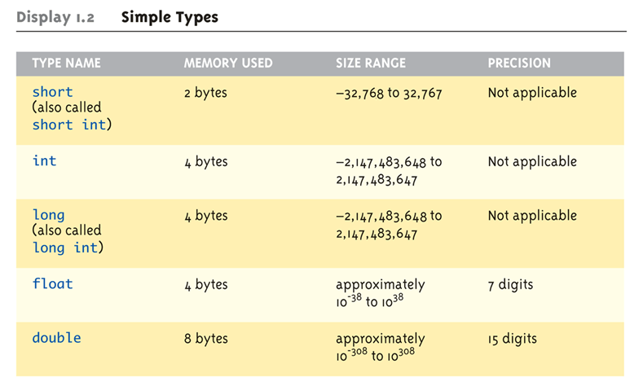
Simple Data Types

Slide 28
Simple Data Types
Important Data Types

Slide 29
More Simple Data Types

Slide 30
More Simple Data Types
Important Data Types

Slide 31
Data Types
One of the big changes from Python to C++
Variables can only be of one type
A string cannot be changed into a list
A tuple cannot be changed into a dictionary
An integer is always an integer – forever
A variable’s type must be explicitly declared

Slide 32
Assigning Data
You can initialize data in declaration statement
Results will be "undefined" if you don’t initialize!
int myValue = 0;
Assigning data during execution
Lvalues (left-side) & Rvalues (right-side)
Lvalues must be variables
Rvalues can be any expression
Example: distance = rate * time;
Lvalue: "distance“
Rvalue: "rate * time"

Slide 33
Data Assignment Rules
Compatibility of Data Assignments
Type mismatches
Cannot place value of one type into variable of another type
intVar = 2.99; → 2 is assigned to intVar!
Only the integer part "fits", so that’s all that goes
Called "implicit" or "automatic type conversion"
Literals
2, 5.75, 'Z', "Hello World\n"
Also known as "constants": can’t change in program

Slide 34
Literal Data
Literals
Examples:
2 // Literal constant int
5.75 // Literal constant double
'Z' // Literal constant char
"Hello World\n" // Literal constant string
Cannot change values during execution
Called "literals" because you "literally typed" them in your program!

Slide 35
Announcements
There will be an important handout on Tuesday, which will only be available in class
The Blackboard site will be available soon
Next Time: Continuation of the C++ Primer, and we’ll begin Functions

